Slide 1
Module 8 – Adding New Features to Alien Invasion
Sharon ONeal
sharononeal@email.arizona.edu
520-822-4040

Slide 2
Unit 1 – Your Task: Adding New Features to Alien Invasion

Slide 3
New Features You are Responsible for Adding to Alien Invasion
Additional Features Required for Alien Invasion
1) Implement and get the basic Alien Invasion working as described in the recorded lecture modules in your own python IDE. You are required to satisfy all aspects of the game's functionality up through and including having a player have up to 4 ships that they can play with before ending the game, as was demonstrated in the recorded videos.
2) On your own, design and incorporate the following additional capabilities:
The game shall keep track of the total number of ships that the player has remaining to play with. The number of ships shall be decremented each time an alien destroys one of the player's ship. (Note: if you increase the total number of ships the player can play with, make sure that the game continues to play until all those ships have been expended).

Slide 4
New Features You are Responsible for Adding to Alien Invasion
Additional Features Required for Alien Invasion
The game shall keep track of the total number of aliens that the player has destroyed from the time the game begins until the end of the game and the player has no more ships left.
The game shall display both the number of ships remaining and the number of aliens the player has destroyed on the player's screen. (Note: location is up to the game developer).

Slide 5
What You Need to Submit (due by the last day of class – 12/8)
Additional Features Required for Alien Invasion
Submit the following 3 things:
ALL source code in the appropriate assignment folder.
A summary of the changes that you made. The summary of changes should be a short, written summary in word and submitted in the appropriate assignment folder.
A video of the complete game playing on the developer's computer - you can do this by using Zoom, or other recording means that you have available. Submit in the appropriate assignment folder.
Total of 3 different assignment folders

Slide 6
Let’s Look at Some of the Pygames Functions and Methods We Will Be Using in Steps 2-4
Syntax | What it does
pygame.image.load | Loads an image into a new surface, Can pass it a filename or python-like object. (Use BMP images if SDL_image support was not installed)
pygame.rect() | Creates a new rectangle object. The given rectstyle represents one of the various ways of representing rectangle data. This is usually a sequence of x and y position for the top left corner, and the width and height.
Self.screen.blit(source, destpos) | Copies pixels from the source . Return value contains the actual area blitted.
Refer to the Reference Manual that is posted on D2L for more information

Slide 7
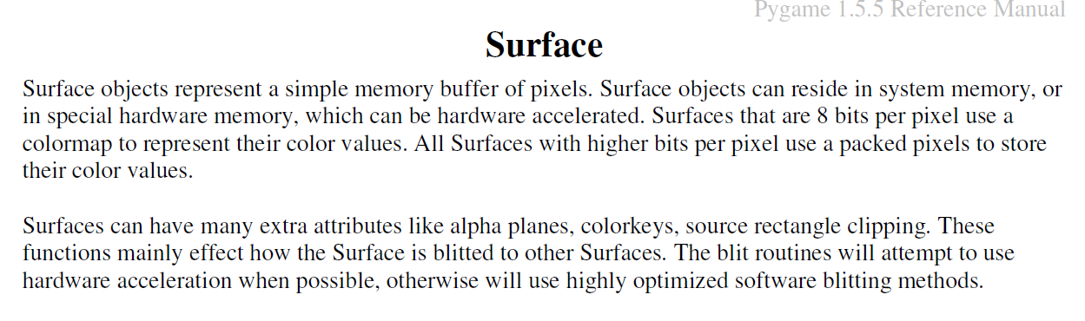
A few things from our Pygame Manual
We will use several functions to manage our ‘surface’ (screen):
surface.blit – copy one surface to another
surface.fill – fill areas of a surface
get_rect – returns a new rectangle covering the entire surface (starting the w,h of the image)
get_size – returns the width (x) and height (y) of the surface
get_width – returns the width of the surface

Slide 8
Preparation
Install an IDE of your choice
Down the following into ONE folder, (This is your working dir, your IDE need to access this folder)
Alien Image
Ship Image
Alien class (as alien.py)
Bullet class (as bullet.py)
Ship class (as ship.py)
Settings class (as settings.py)
GameStatus (as game_stats.py)

Slide 9
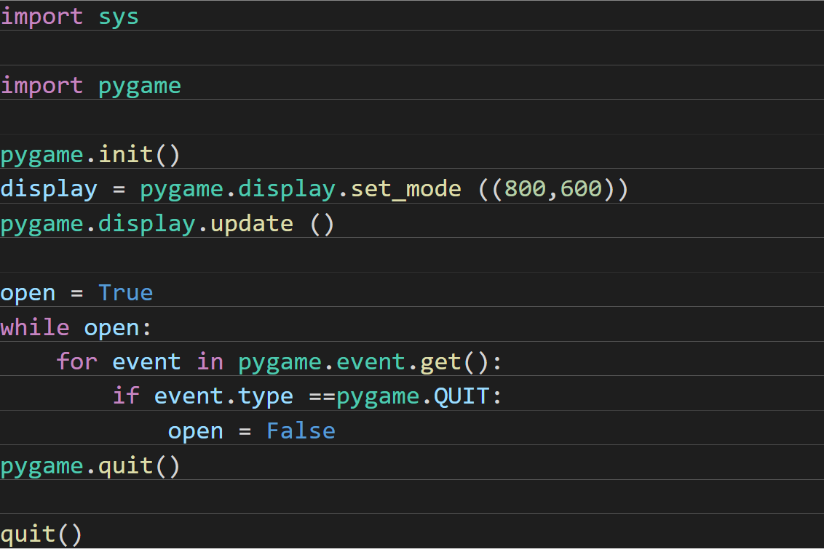
Alien Invasion / Step 0: Import pygame

Slide 10
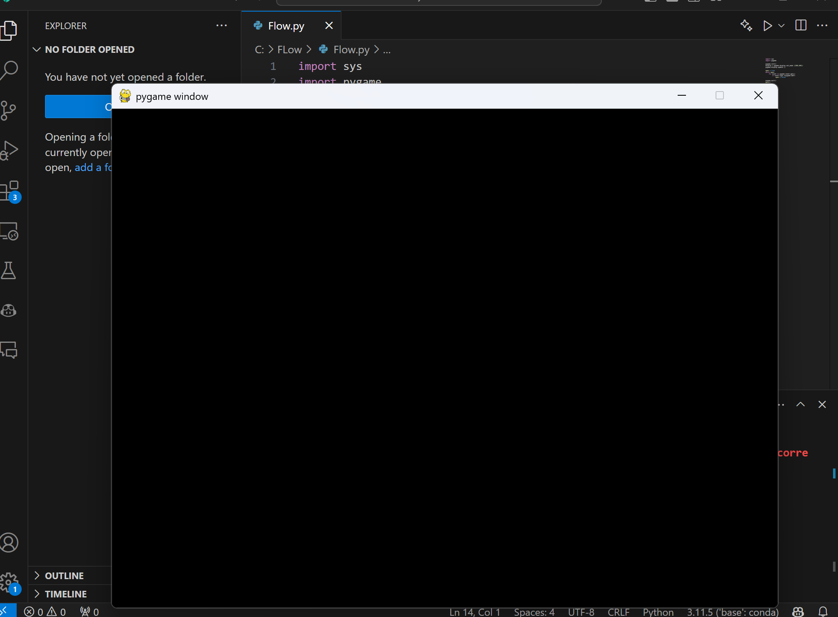
Alien Invasion / Step 0: Import pygame

Slide 11
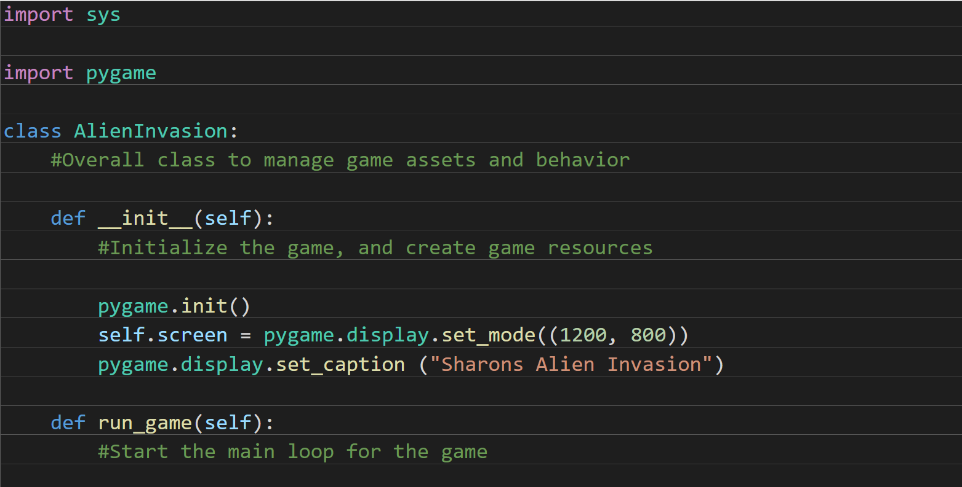
Alien Invasion / Step 1: Alien Display Gameboard (1 of 2)

Slide 12
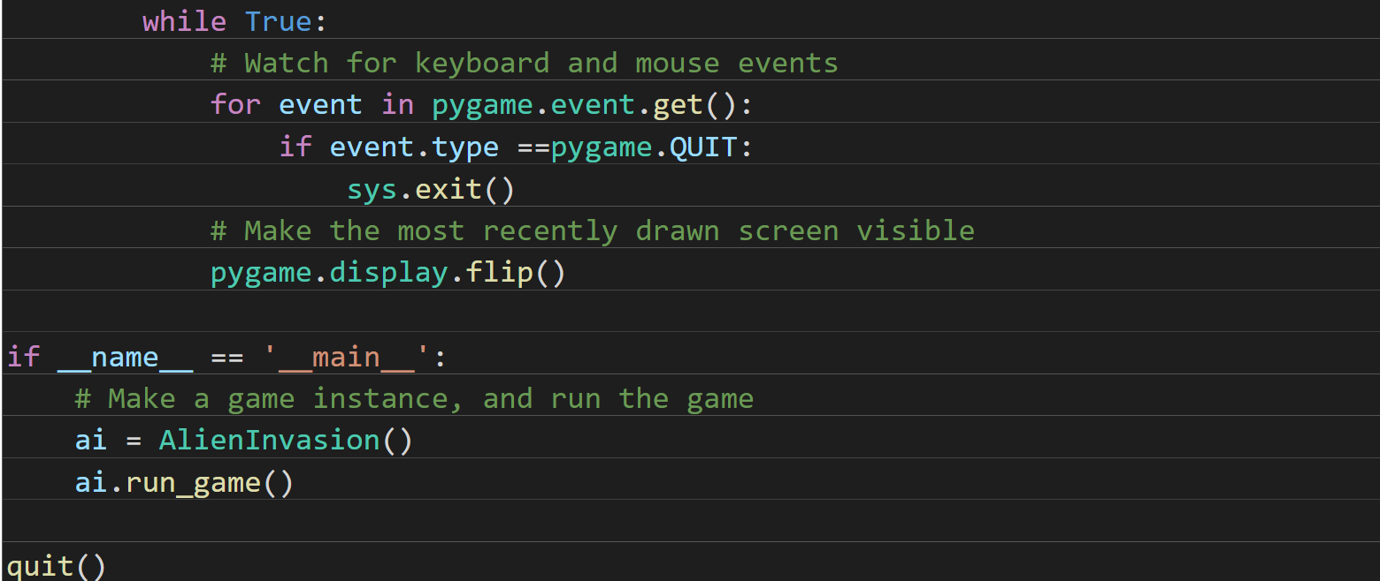
Alien Invasion / Step 1: Alien Display Gameboard (2 of 2)

Slide 13
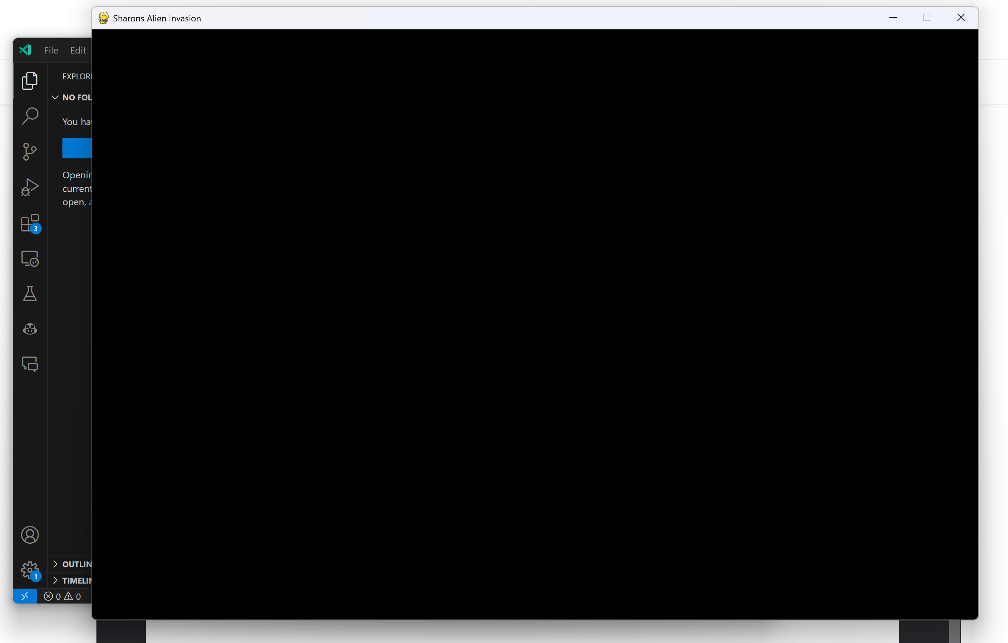
Alien Invasion / Step 1: Alien Display Gameboard

Slide 14
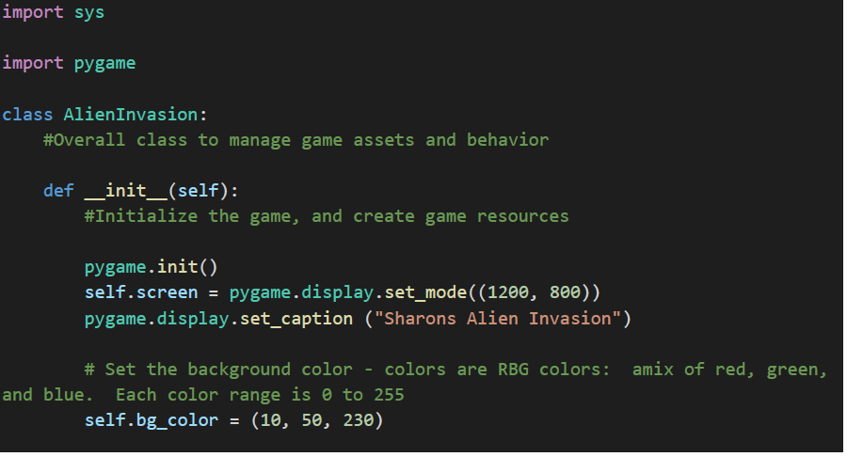
Alien Invasion / Step 2: Change Background Color (1 of 2)

Slide 15
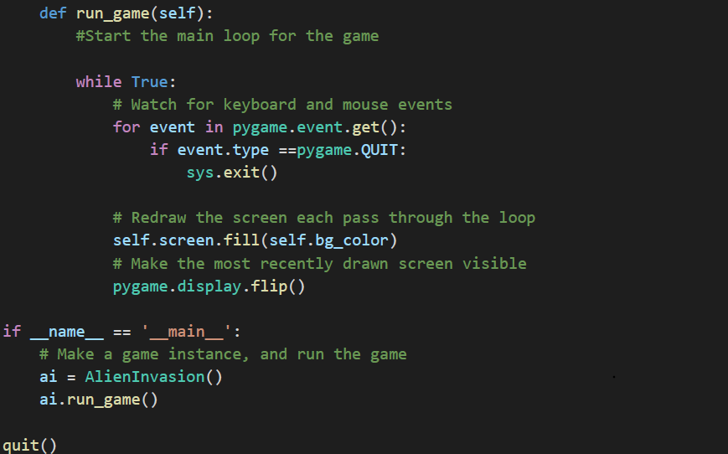
Alien Invasion / Step 2: Change Background Color (2 of 2)

Slide 16
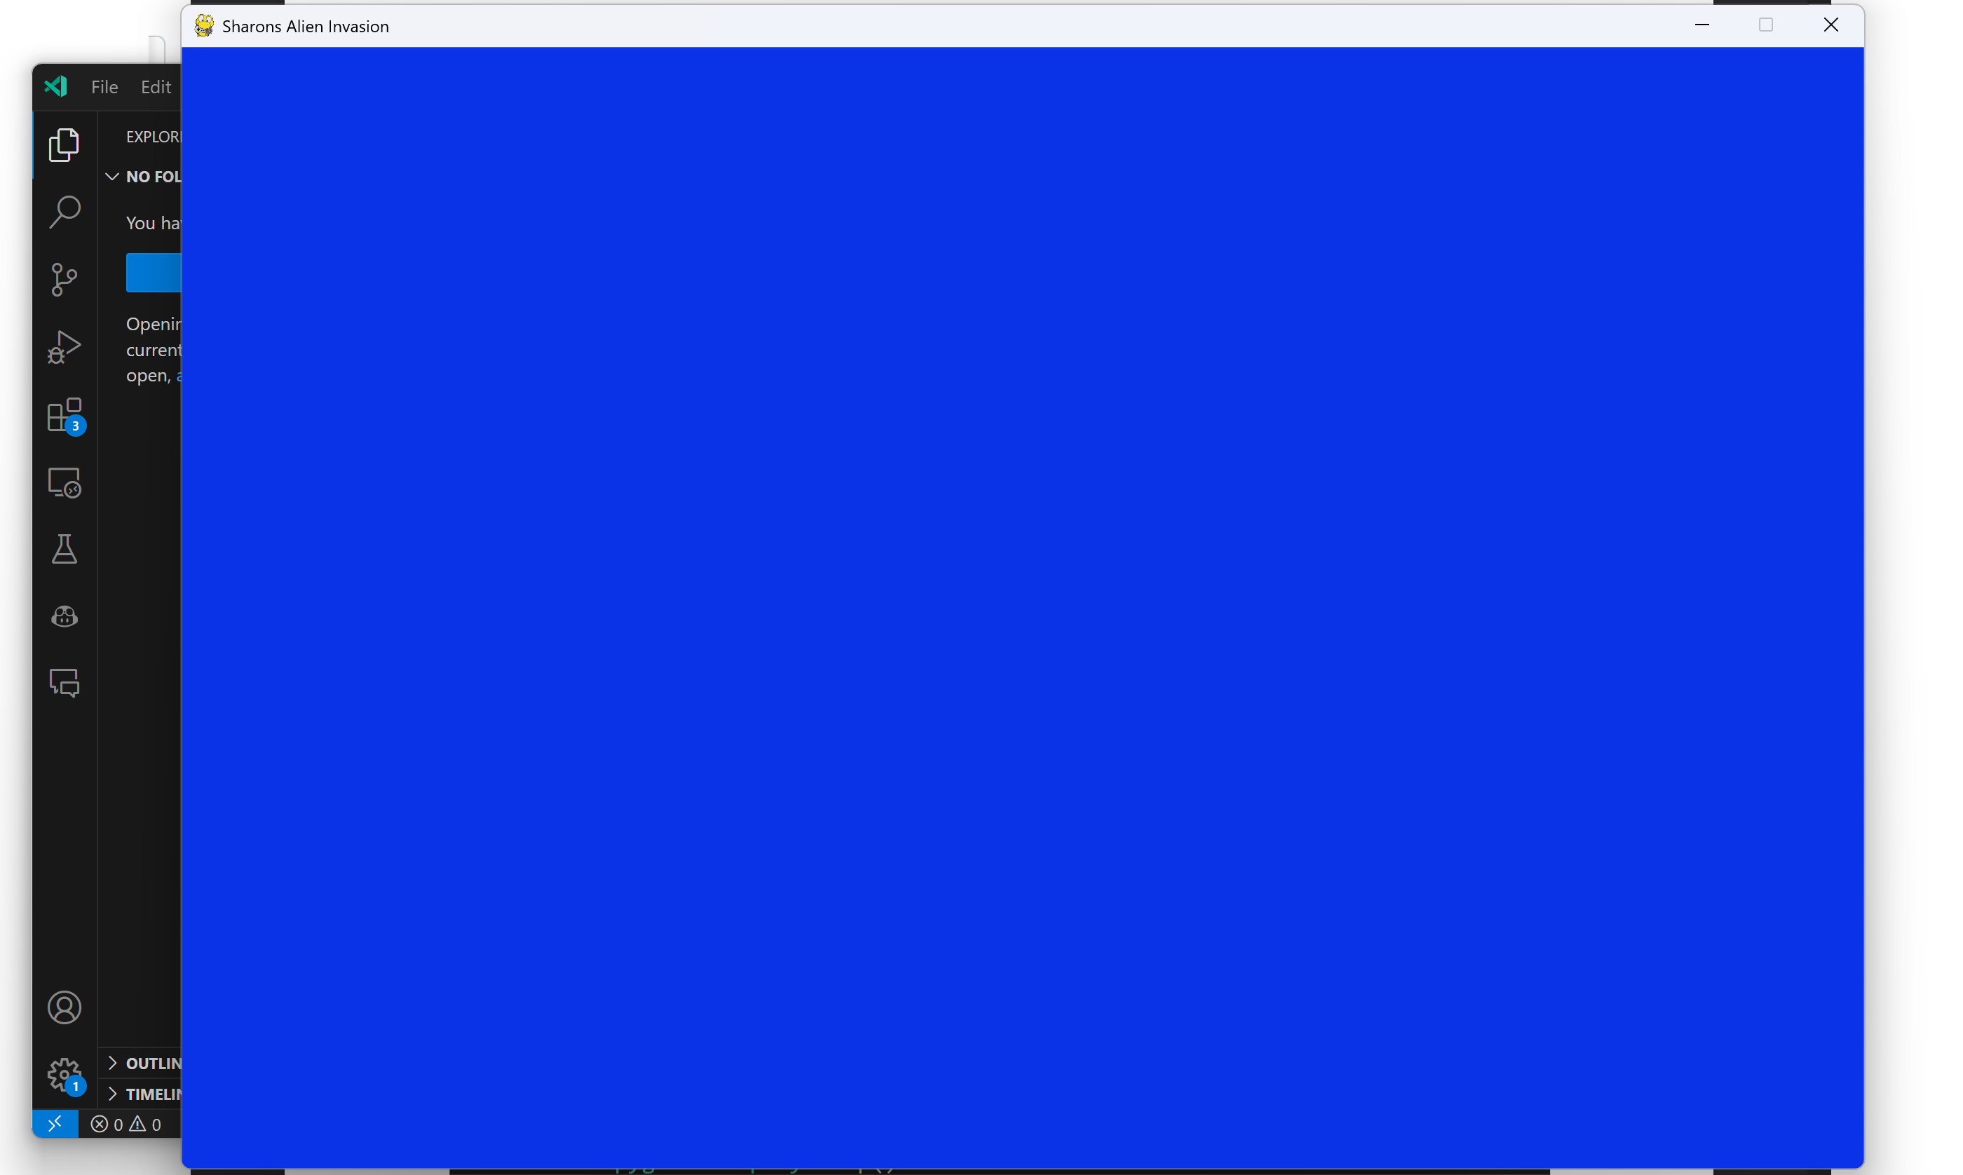
Alien Invasion / Step 2: Change Background Color

Slide 17
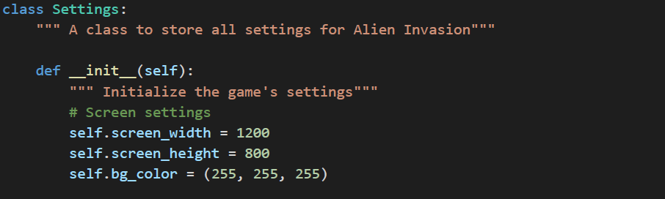
Alien Invasion / Step 3: Create a Settings Class – (We will add to this as we add more code)

Slide 18
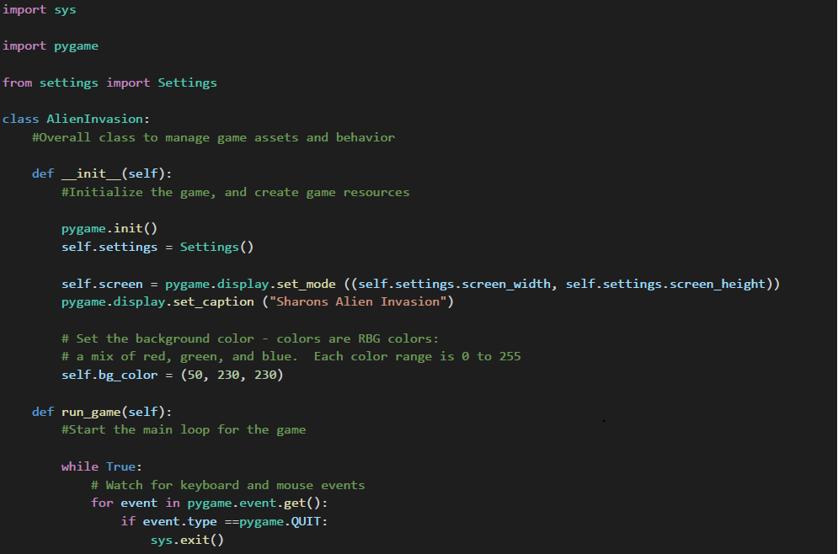
Alien Invasion / Step 3: Add in a Settings Class (2 of 3)
Do we need this if it is in Settings?

Slide 19
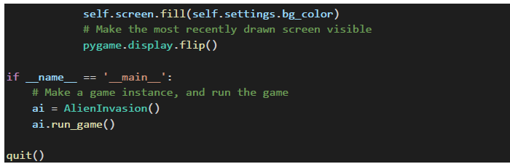
Alien Invasion / Step 3: Add in a Settings Class (3 of 3)

Slide 20
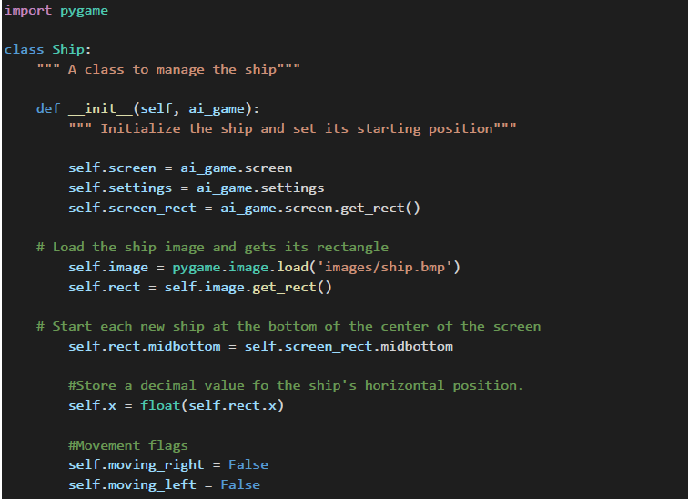
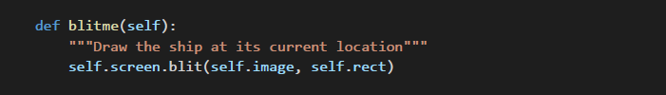
Alien Invasion / Step 4: Create a Ship class
You need to copy in an image of the ship (you can find on D2L or use your own)
Alien Invasion / Step 4: Create a Ship class
(we will add more to it later)

Slide 21
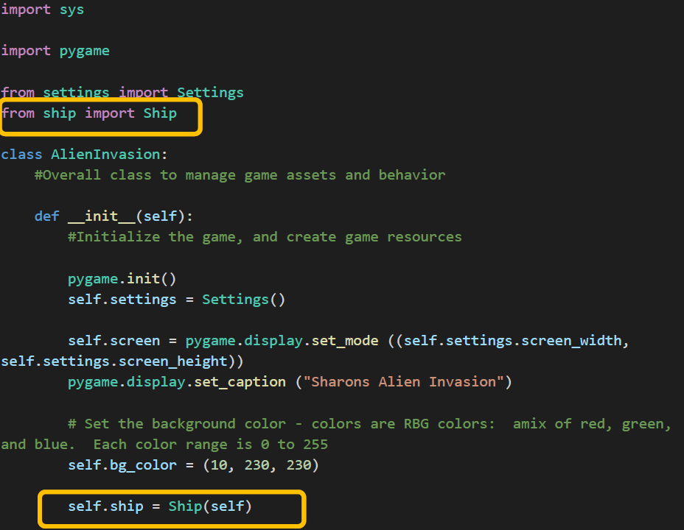
Alien Invasion / Step 4: Drawing Ship to Screen

Slide 22
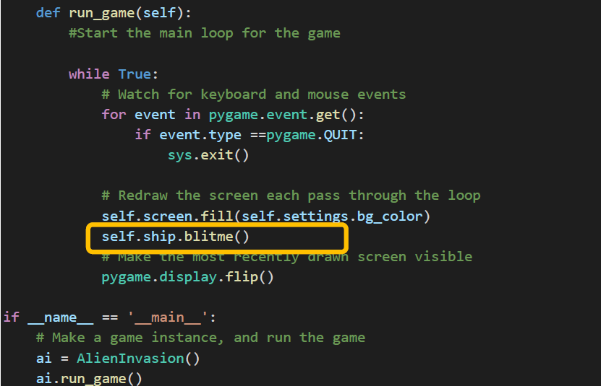
Alien Invasion / Step 4: Drawing Ship to Screen

Slide 23
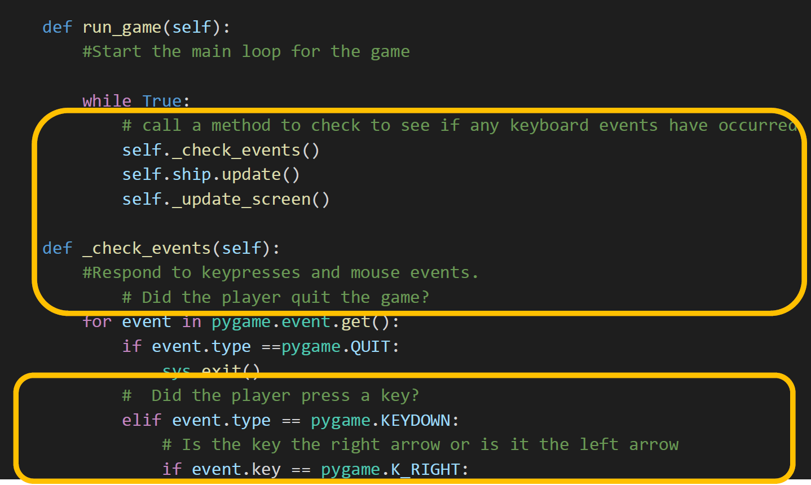
Alien Invasion / Step 5: Alien Refactor and Arrow Keys (1 of 2)

Slide 24
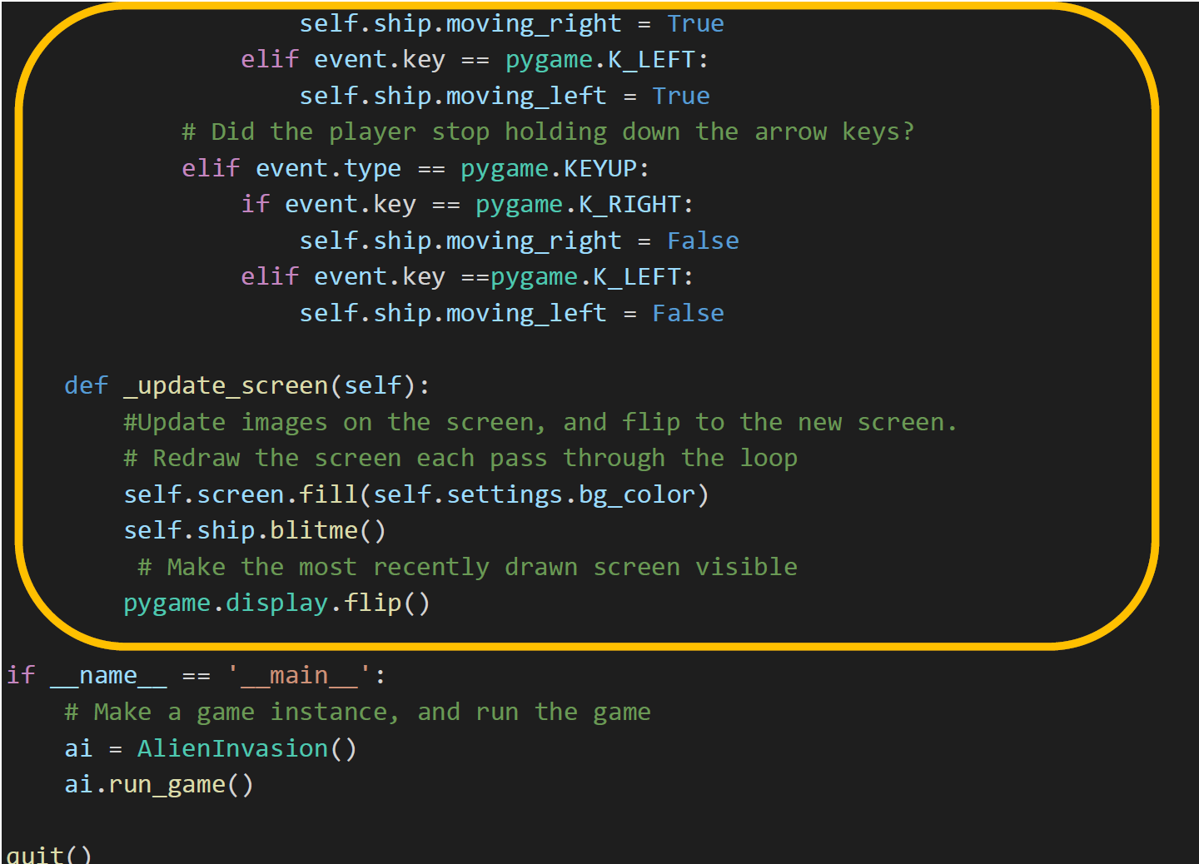
Alien Invasion / Step 5: Alien Refactor and Arrow Keys (2 of 2)

Slide 25
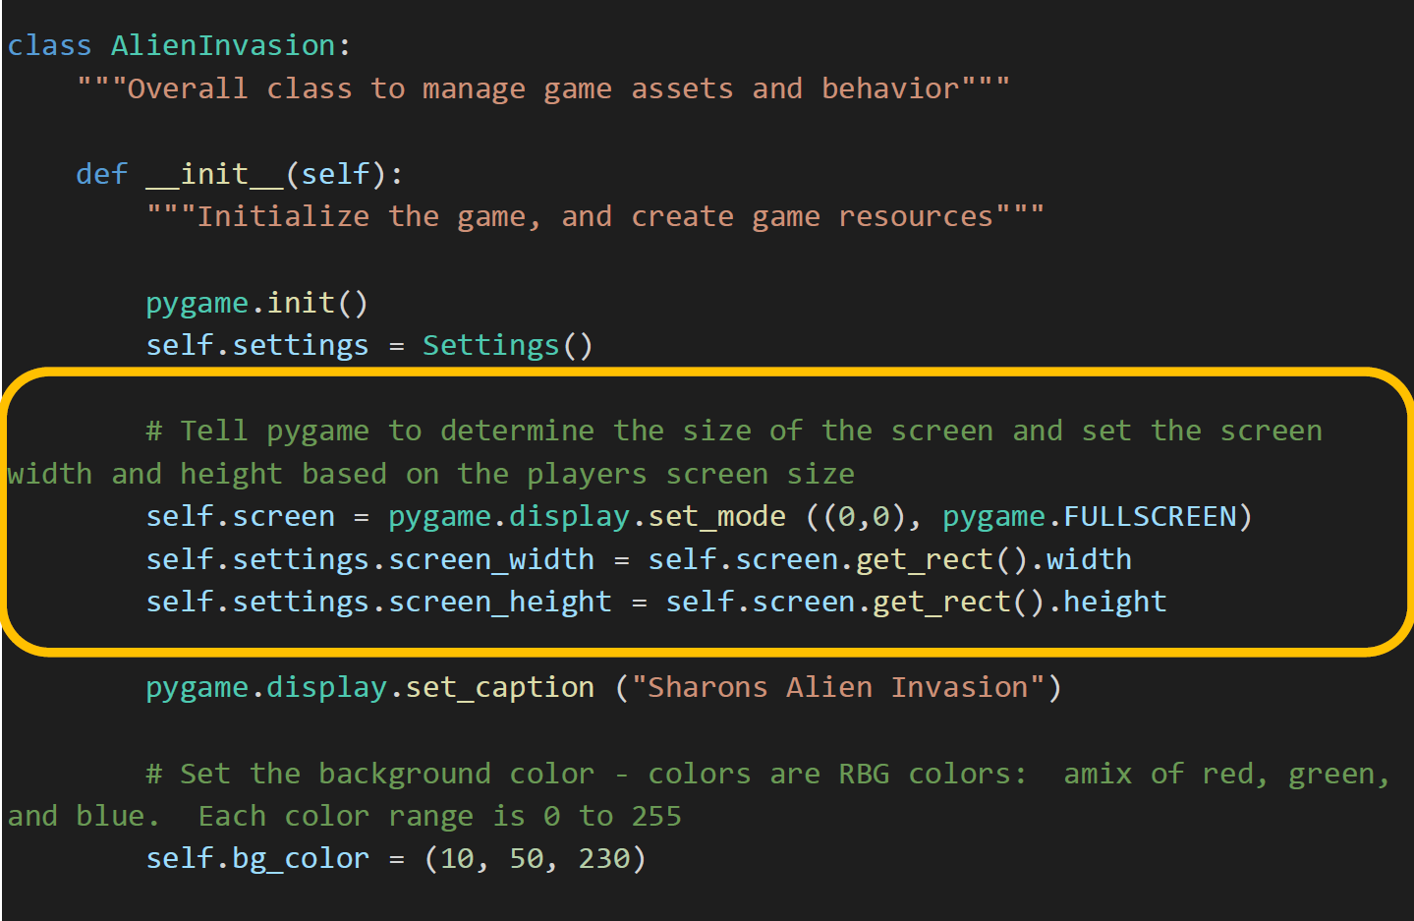
Alien Invasion / Step 6: Alien Ship Speed and Range (1 of 2)

Slide 26
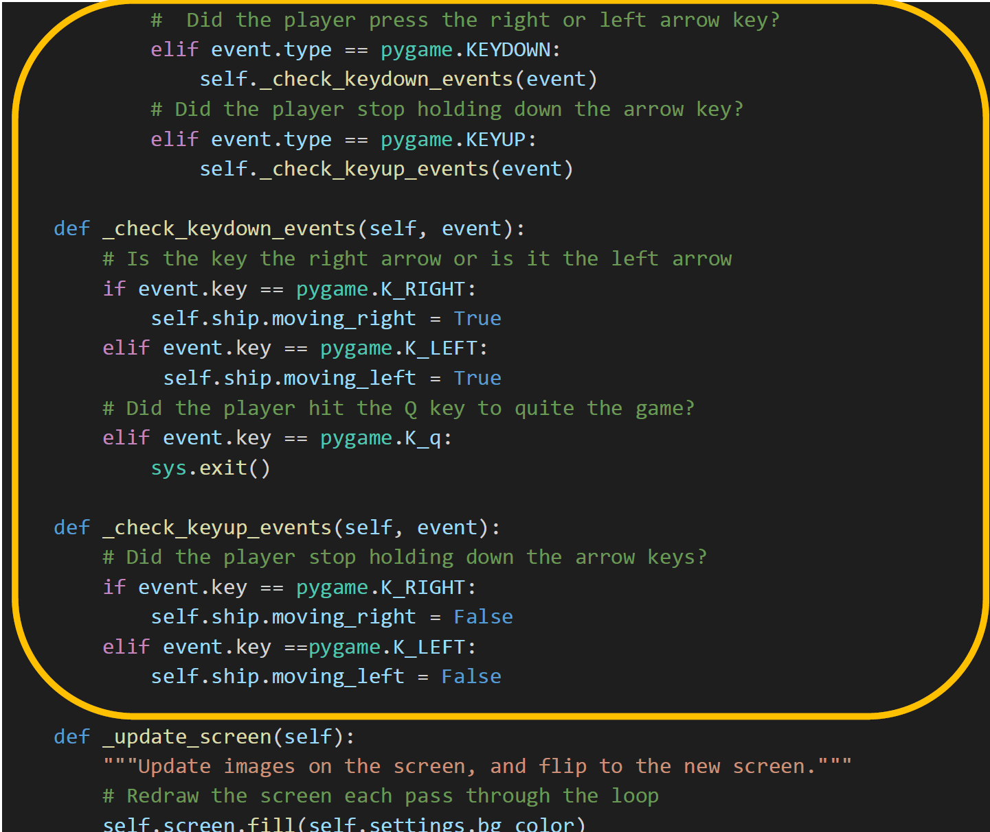
Alien Invasion / Step 6: Alien Ship Speed and Range (2 of 2)

Slide 27
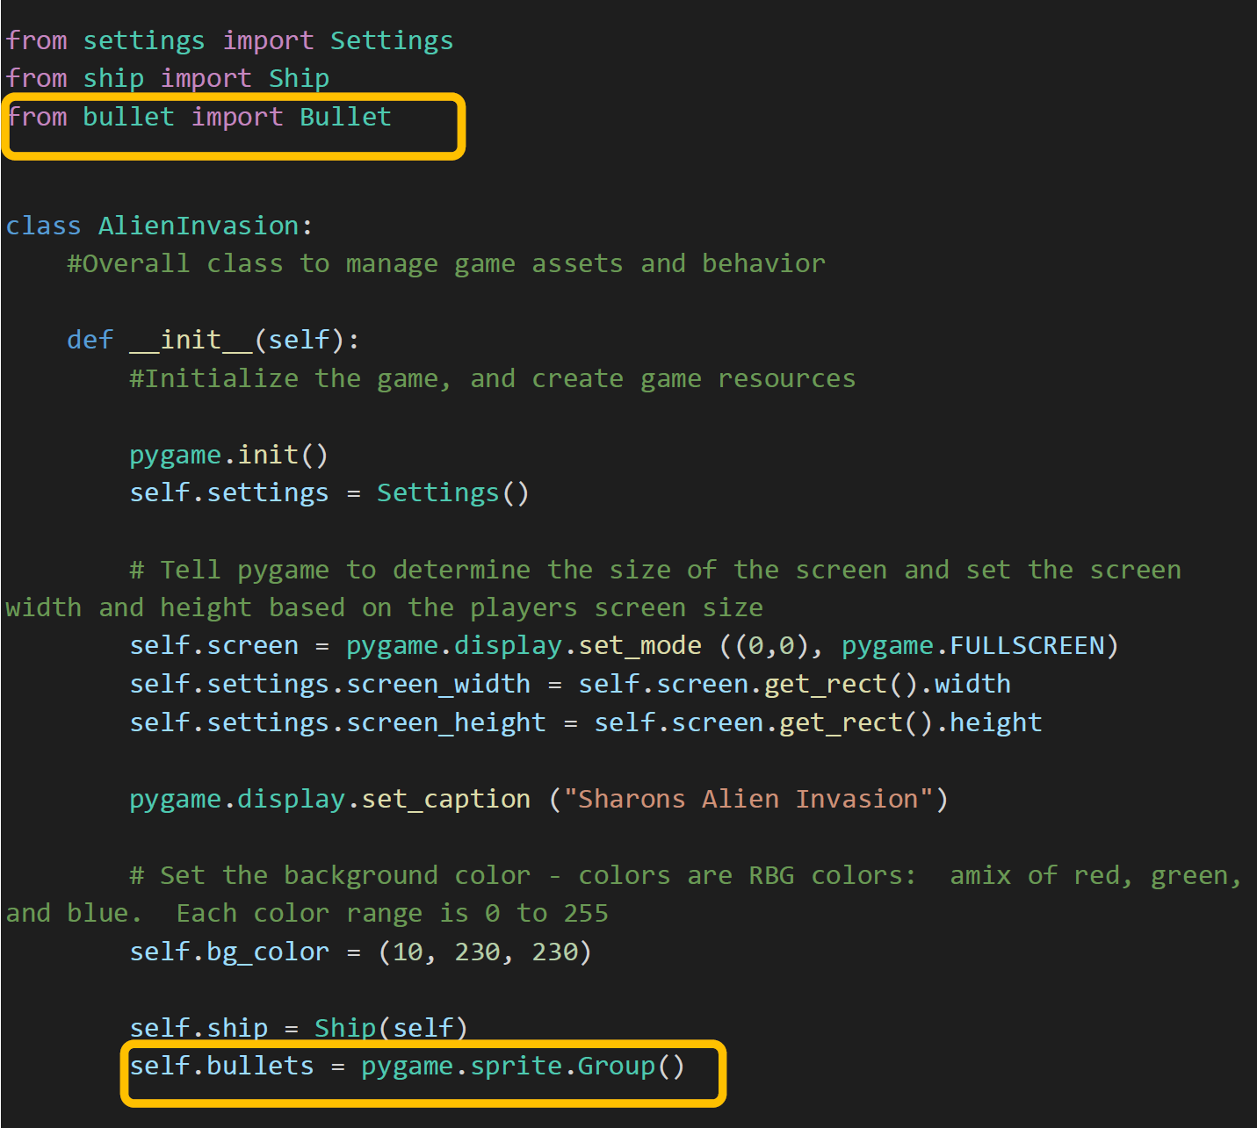
Alien Invasion / Step 7: Alien Shoot Bullets (1 of 6)

Slide 28
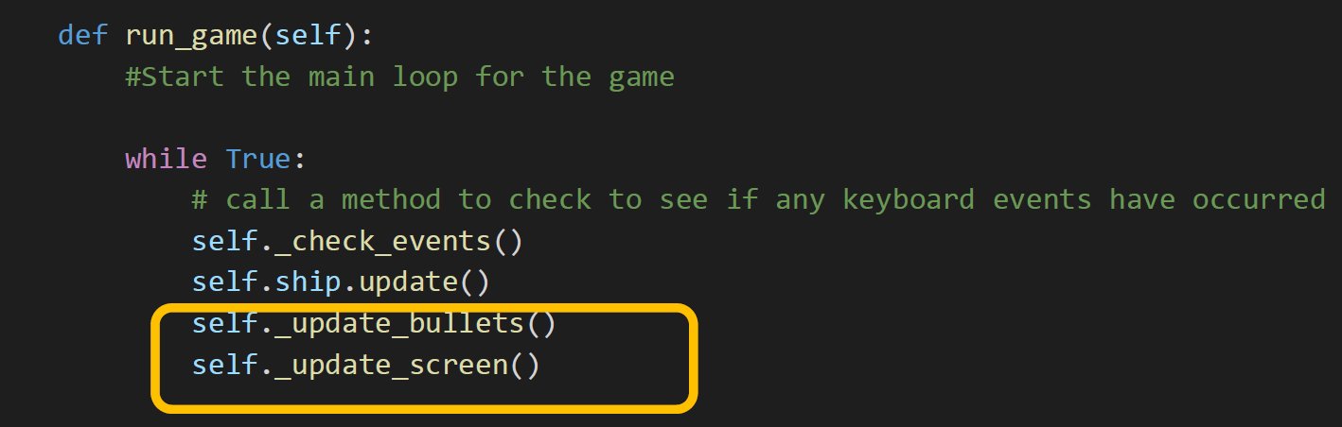
Alien Invasion / Step 7: Alien Shoot Bullets (2 of 6)

Slide 29
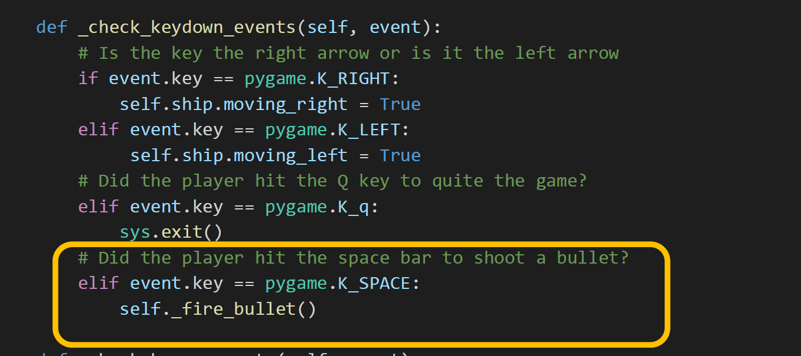
Alien Invasion / Step 7: Alien Shoot Bullets (3 of 6)

Slide 30
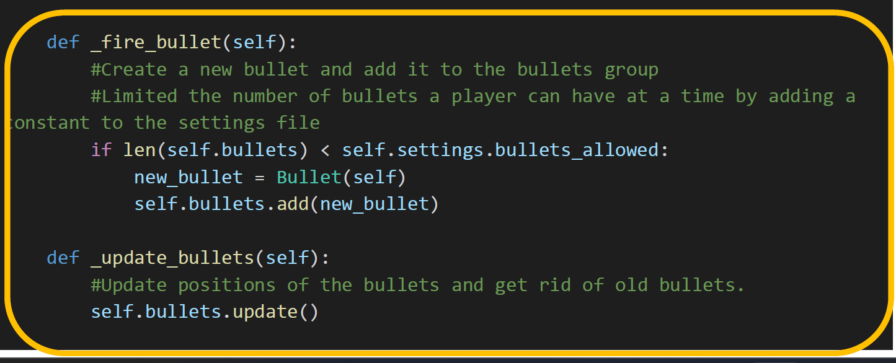
Alien Invasion / Step 7: Alien Shoot Bullets (4 of 6)

Slide 31
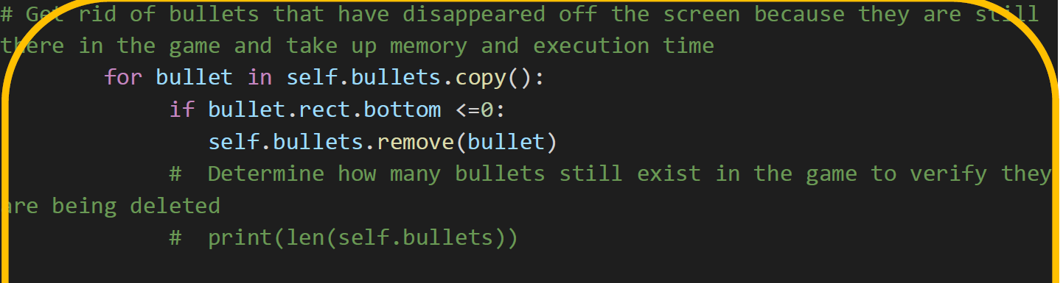
Alien Invasion / Step 7: Alien Shoot Bullets (5 of 6)

Slide 32
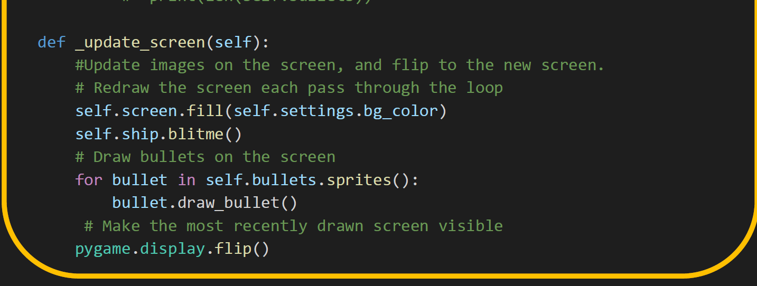
Alien Invasion / Step 7: Alien Shoot Bullets (6 of 6)

Slide 33
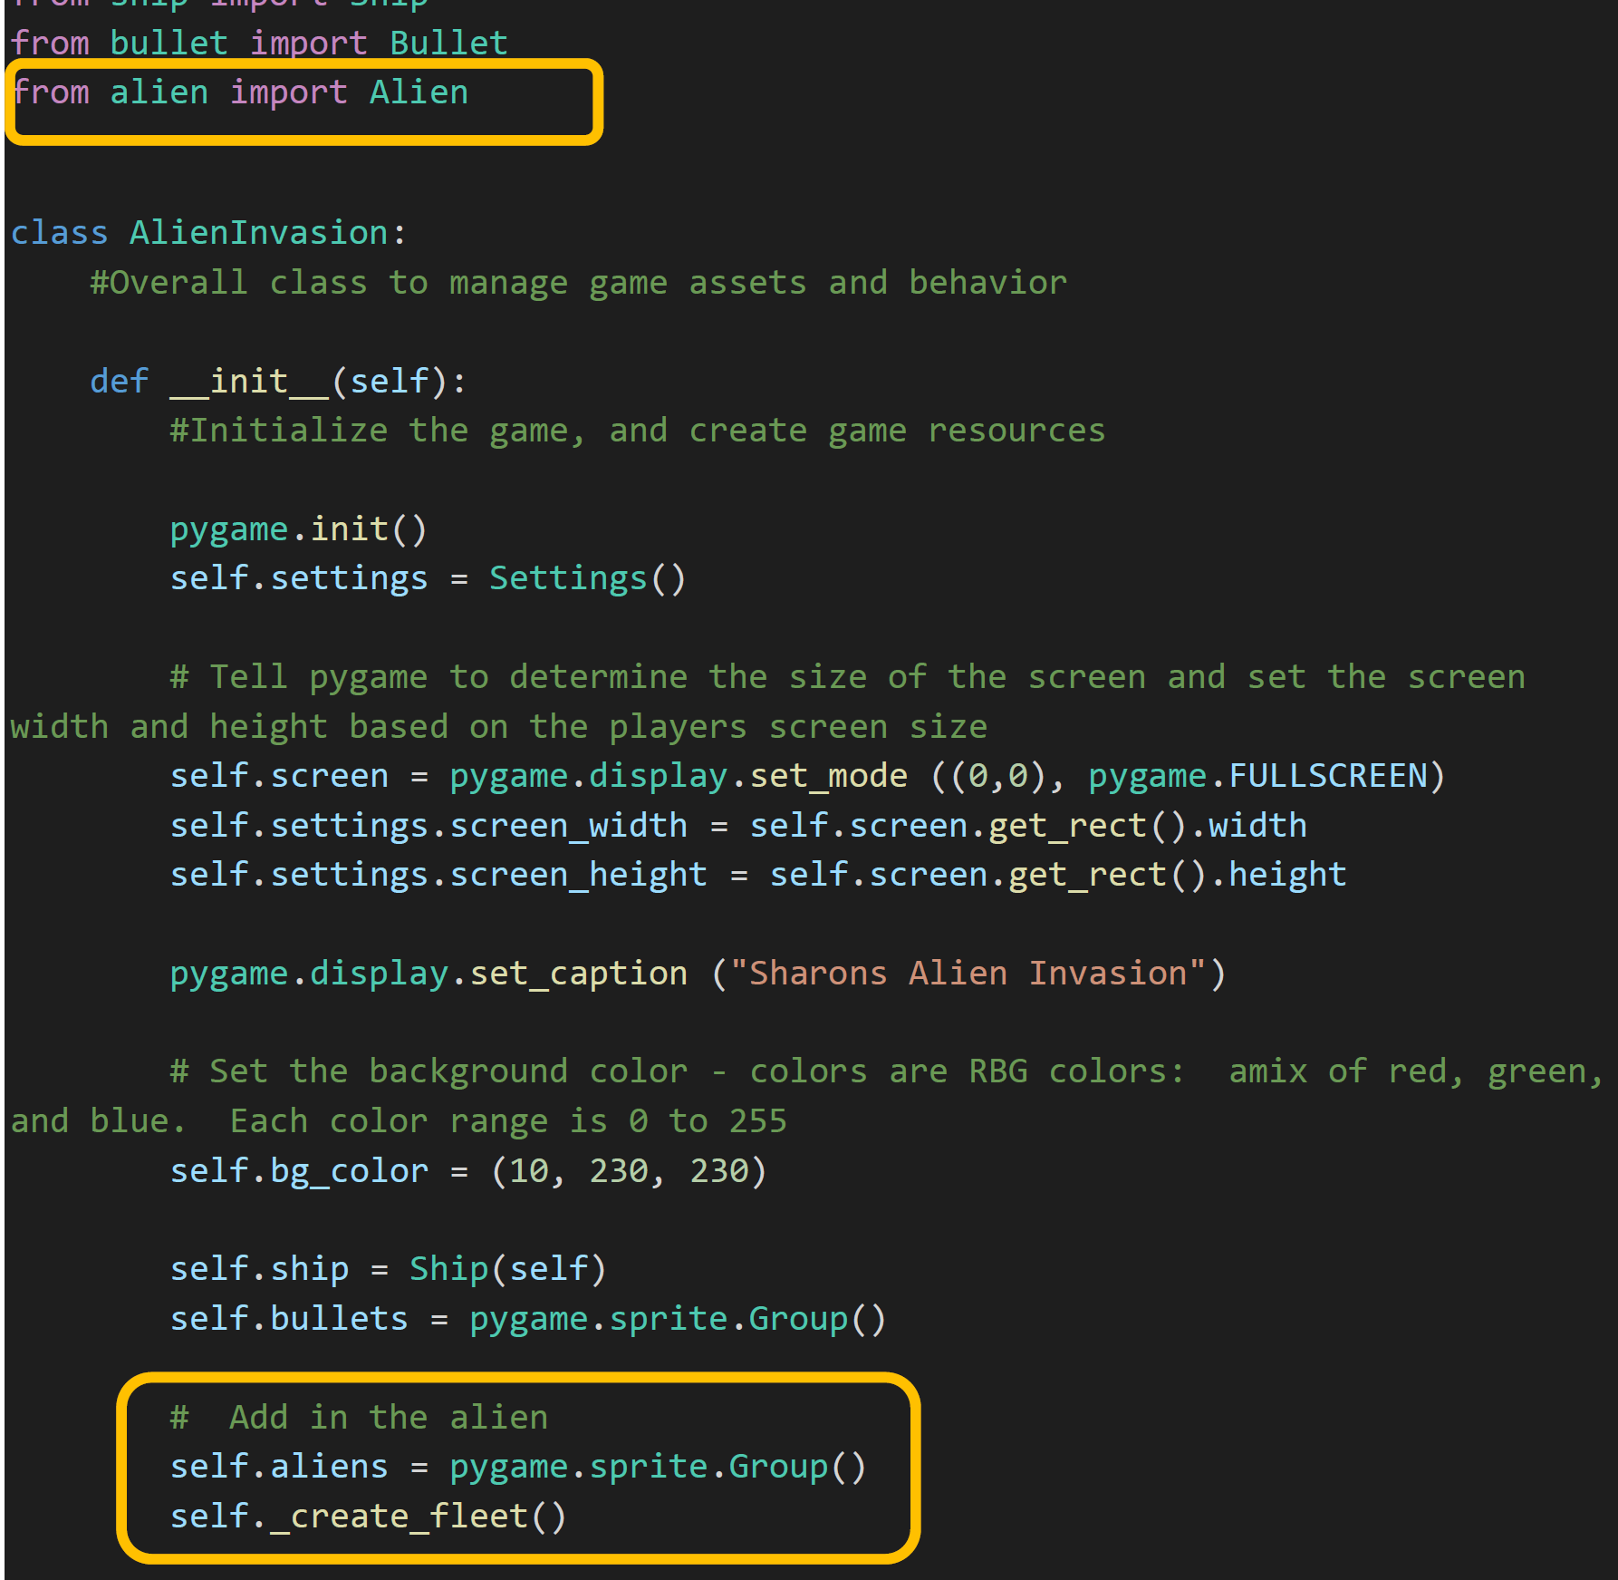
Alien Invasion / Step 8: Alien Place Aliens (1 of 2)

Slide 34
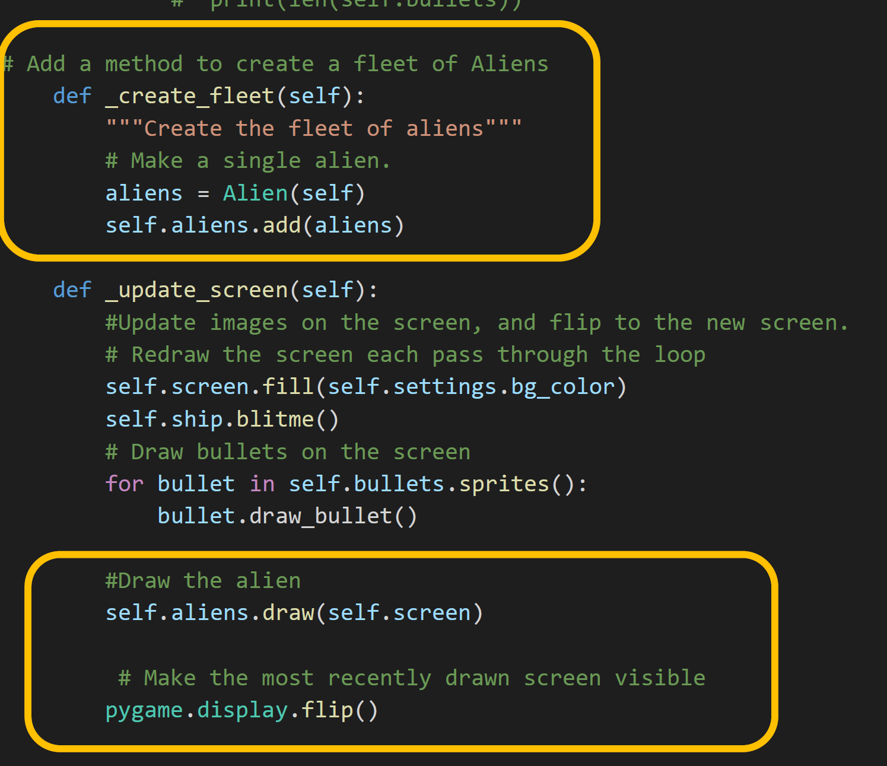
Alien Invasion / Step 8: Alien Place Aliens (2 of 2)

Slide 35
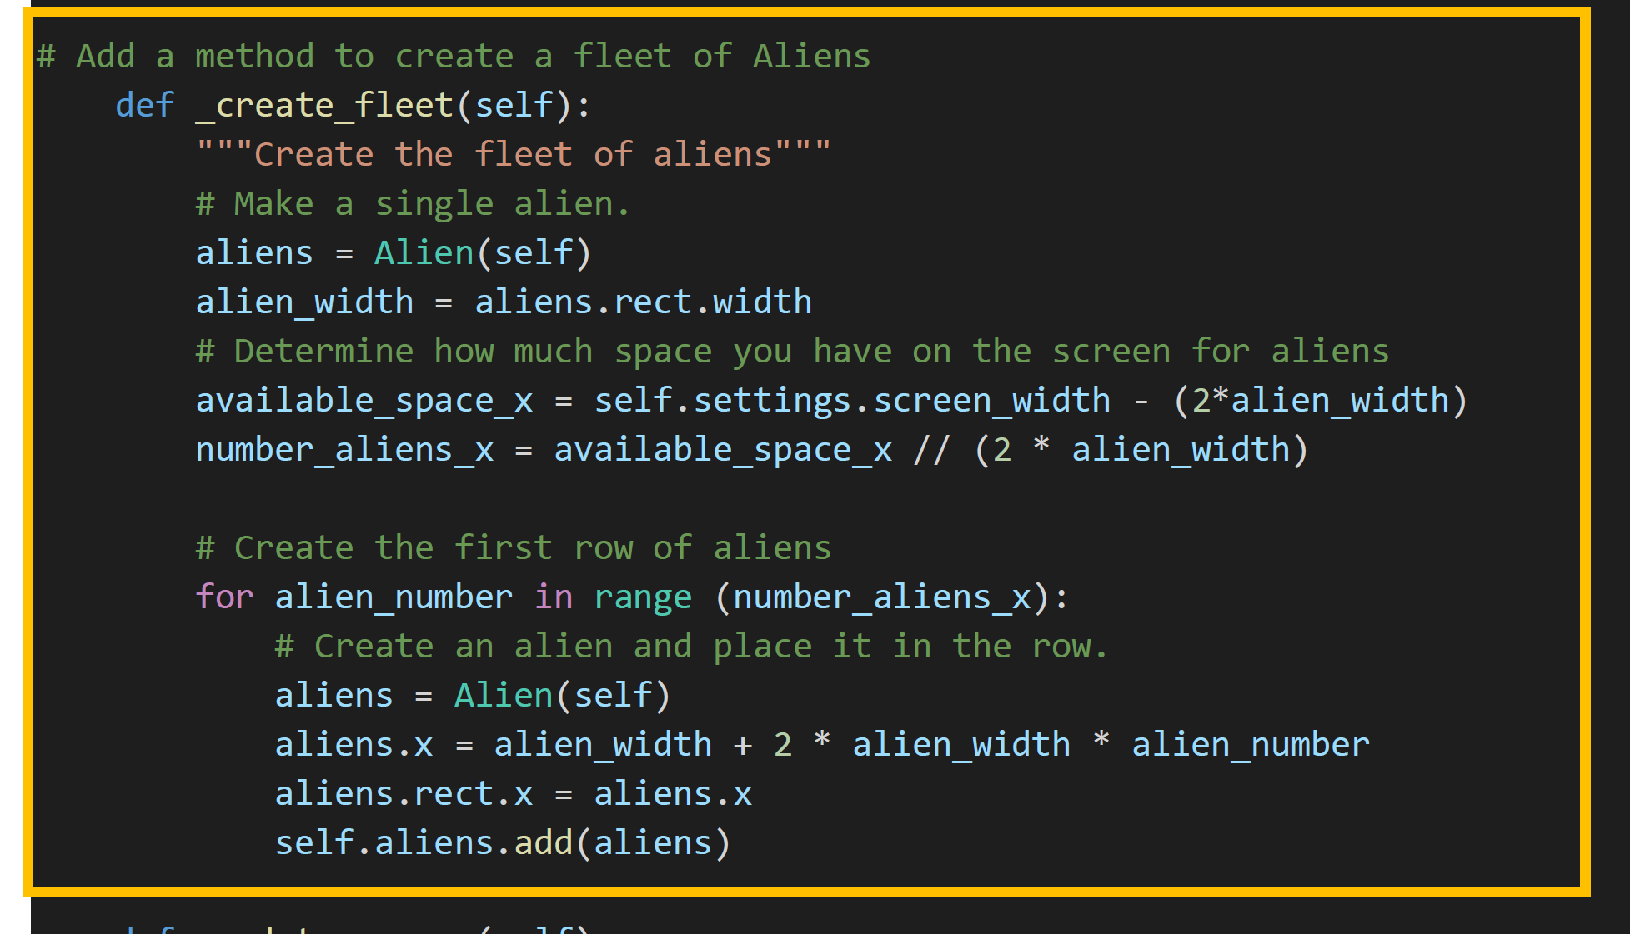
Alien Invasion / Step 9: Alien Creat Alien Fleet

Slide 36
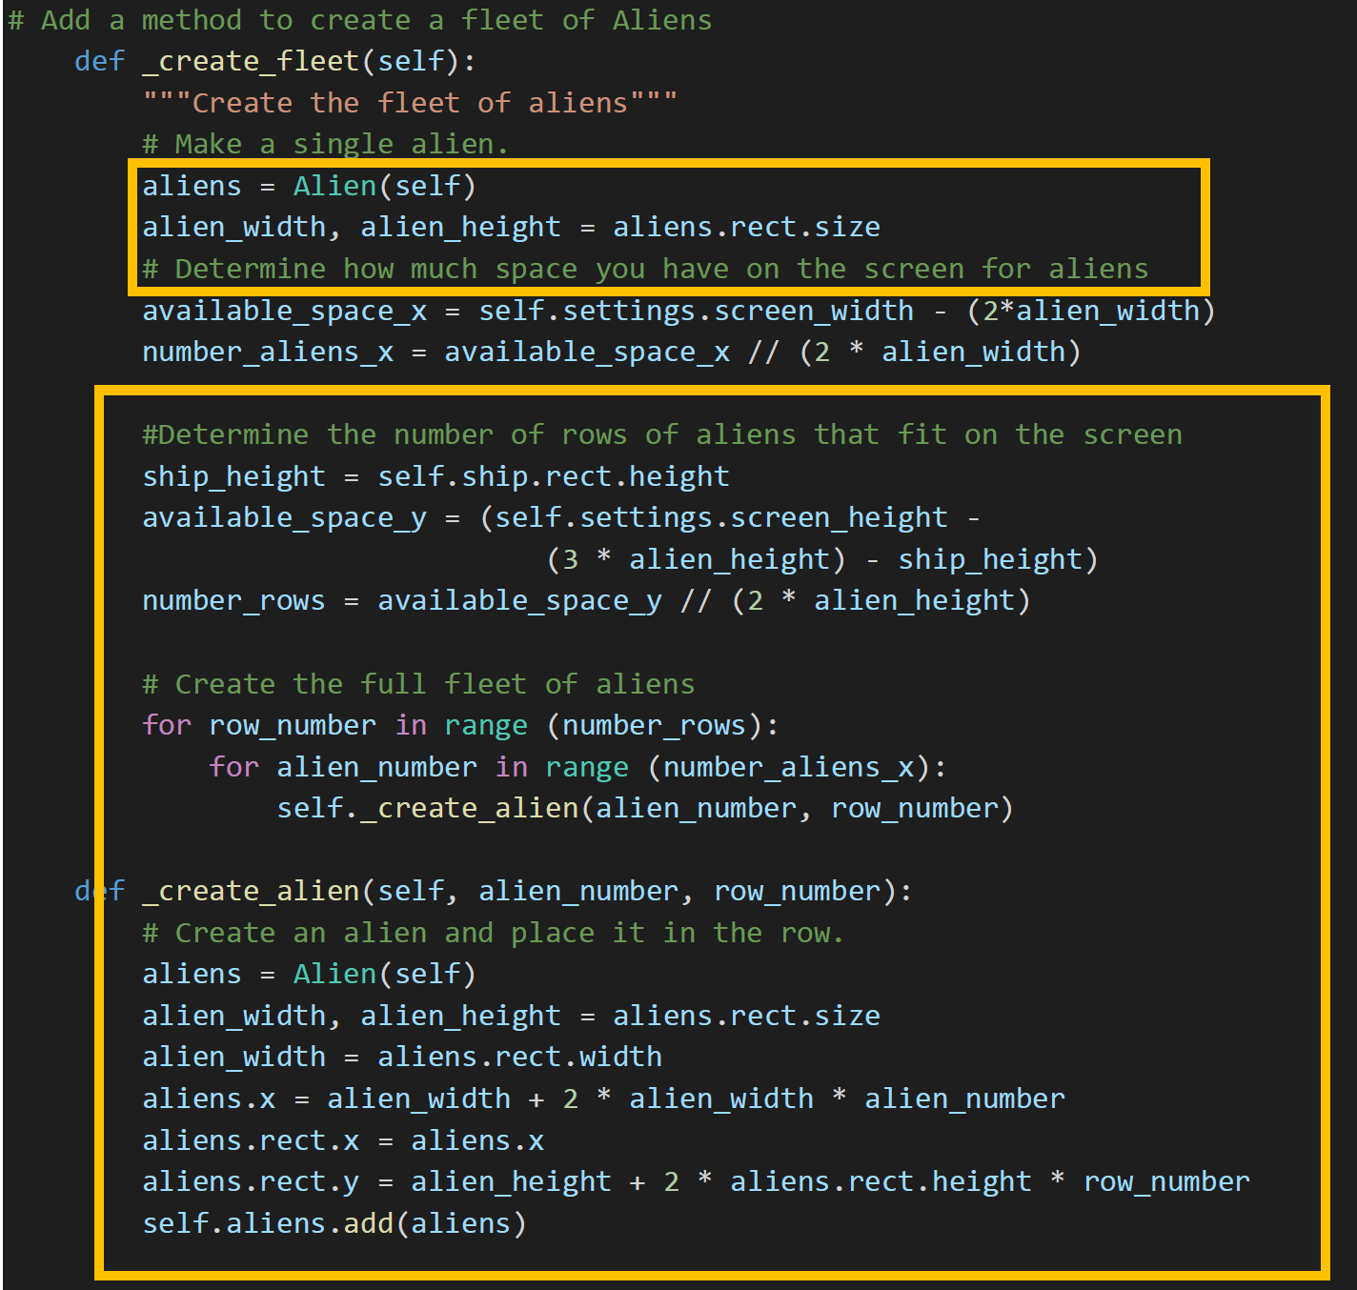
Alien Invasion / Step 10: Alien Rows of Aliens

Slide 37
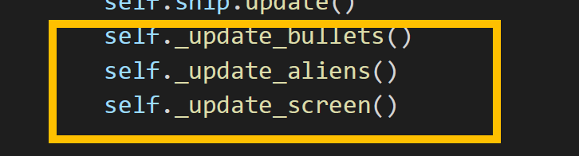
Alien Invasion / Step 11: Alien Move Rows of Aliens (1 of 3)

Slide 38
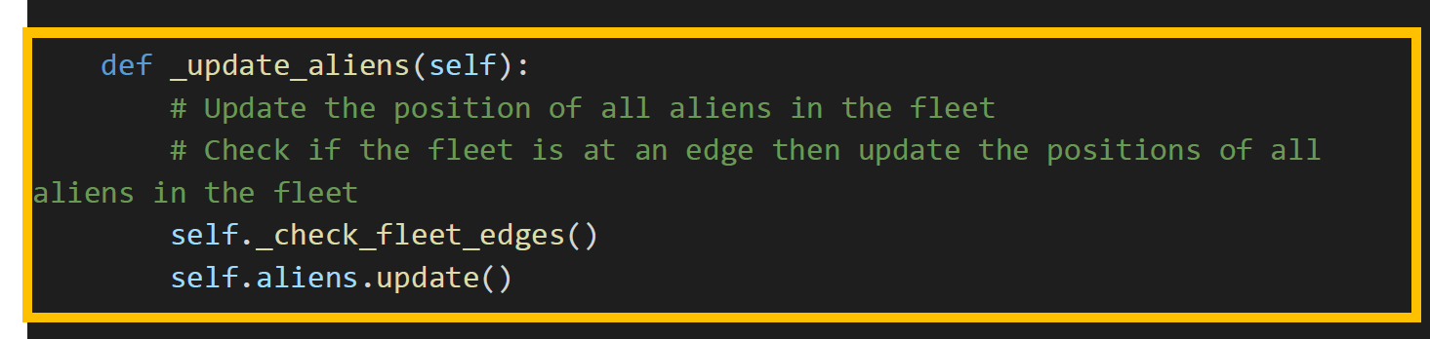
Alien Invasion / Step 11: Alien Move Rows of Aliens (2 of 3)

Slide 39
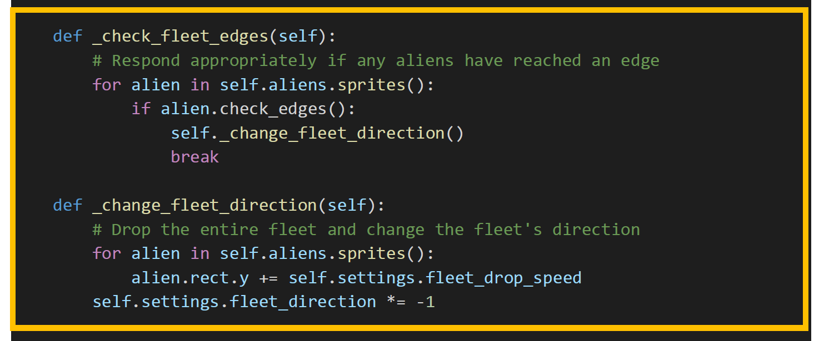
Alien Invasion / Step 11: Alien Move Rows of Aliens (3 of 3)

Slide 40
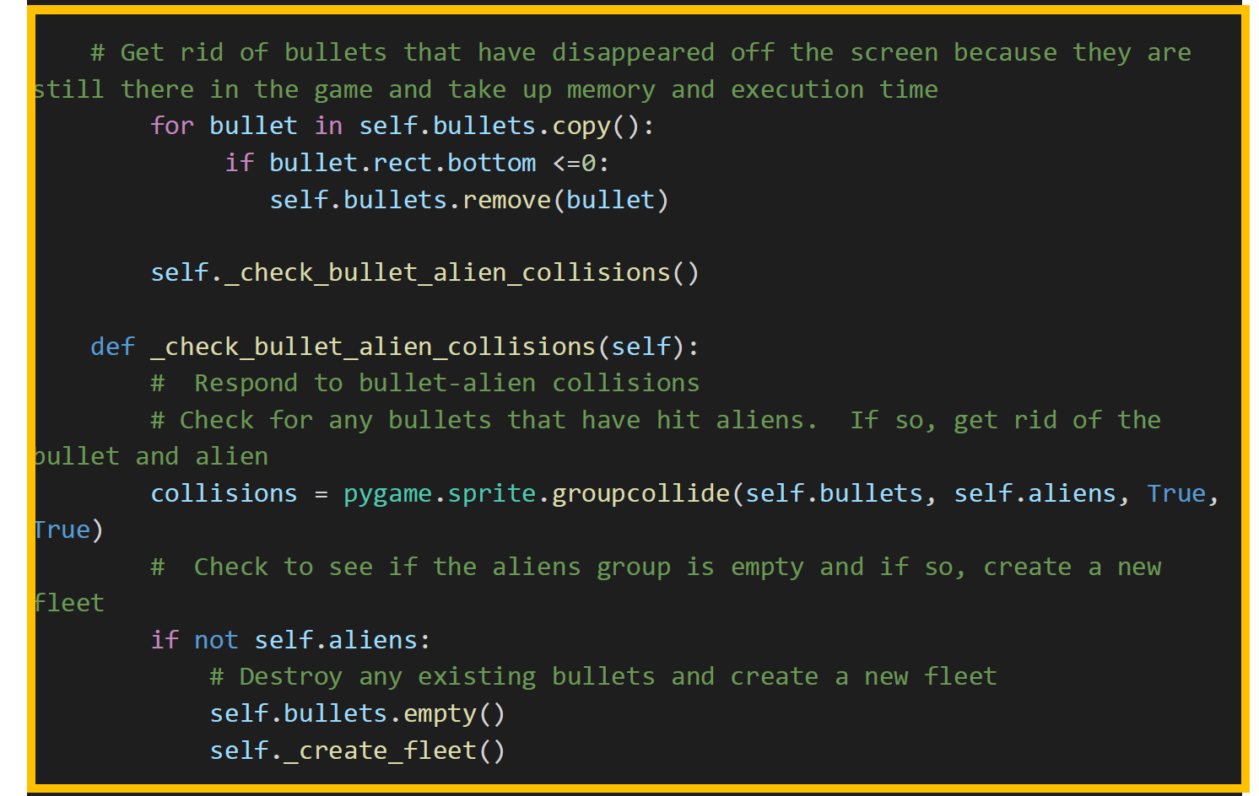
Alien Invasion / Step 12: Alien Shoot Aliens (1 of 2)

Slide 41
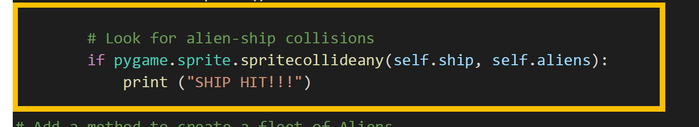
Alien Invasion / Step 12: Alien Shoot Aliens (2 of 2)

Slide 42
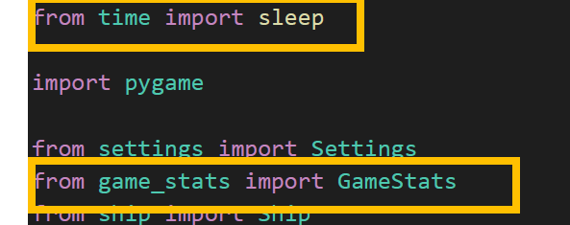
Alien Invasion / Step 13: Alien Multiple Ships with Stats(1 of 5)

Slide 43
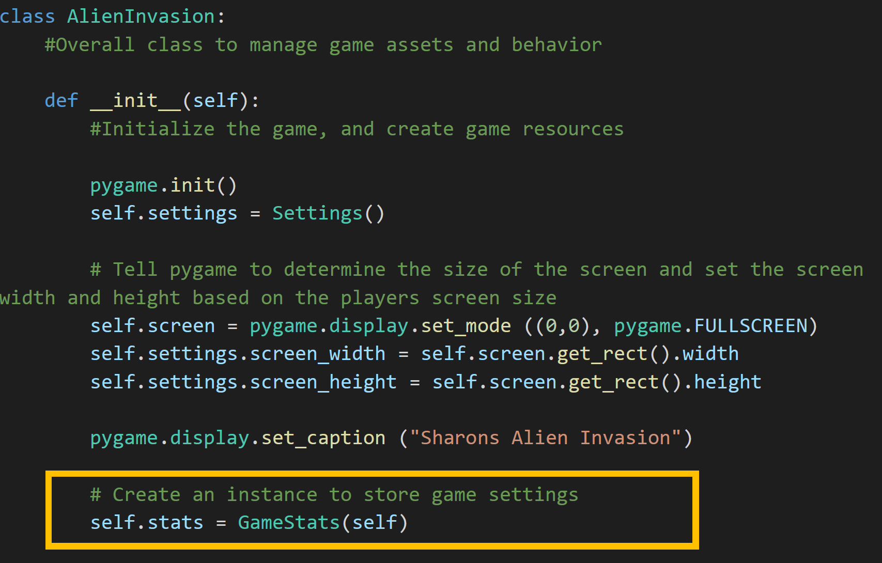
Alien Invasion / Step 13: Alien Multiple Ships with Stats(2 of 5)

Slide 44
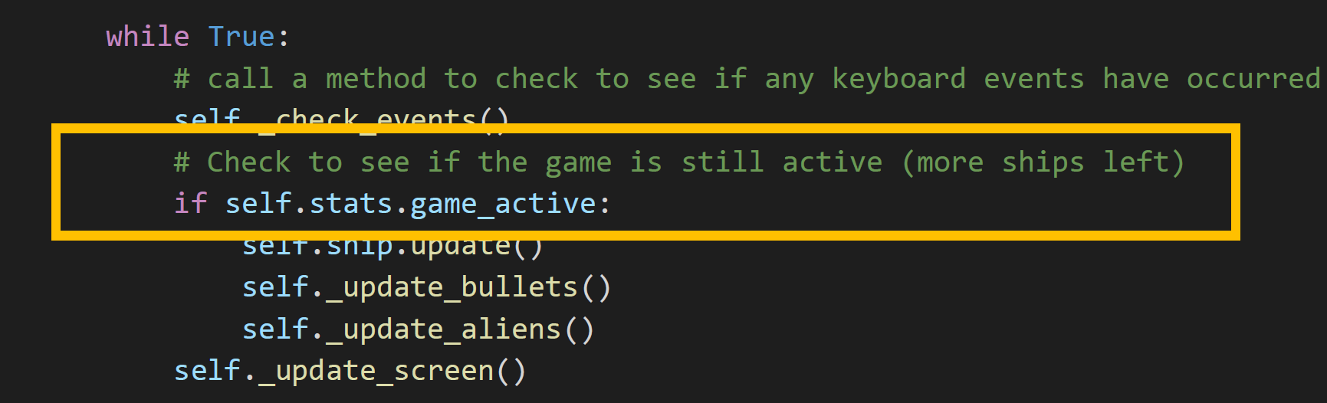
Alien Invasion / Step 13: Alien Multiple Ships with Stats(3 of 5)

Slide 45
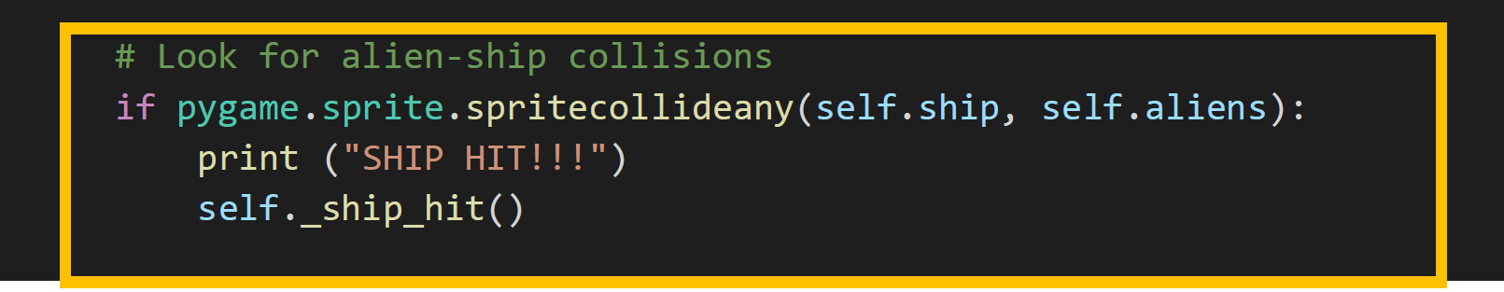

Alien Invasion / Step 13: Alien Multiple Ships with Stats(4 of 5)

Slide 46
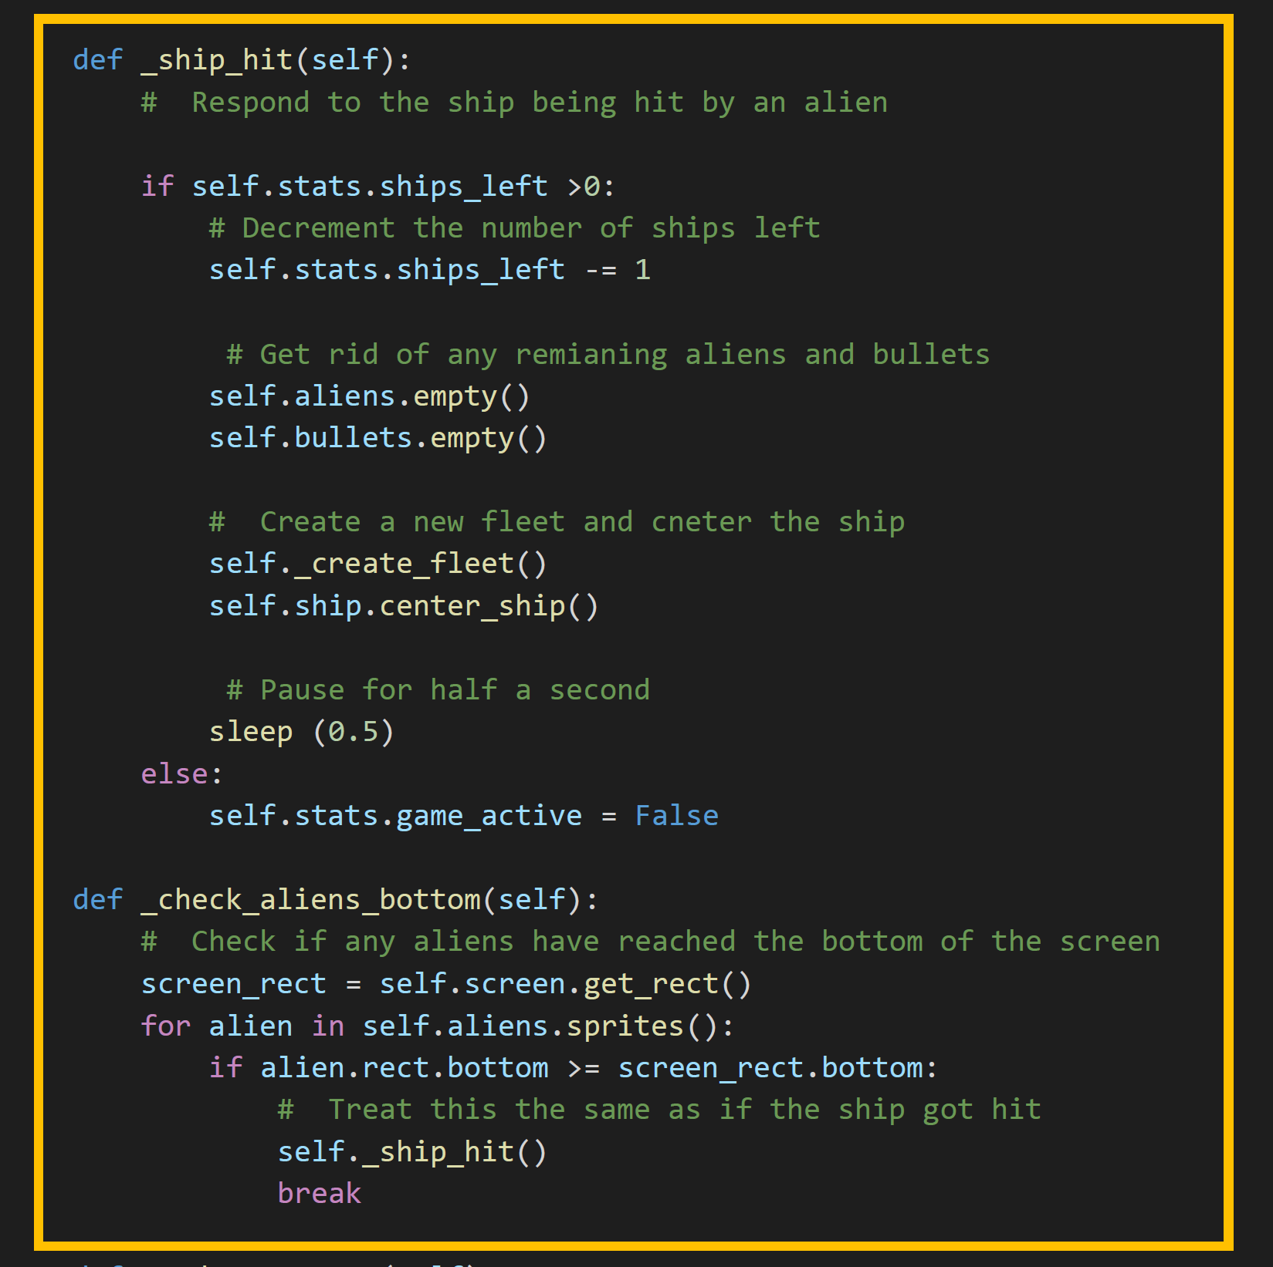
Alien Invasion / Step 13: Alien Multiple Ships with Stats(5 of 5)

